Slide 1

용감한 친구들
DEV EVENT
Since 20. 08

Slide 2
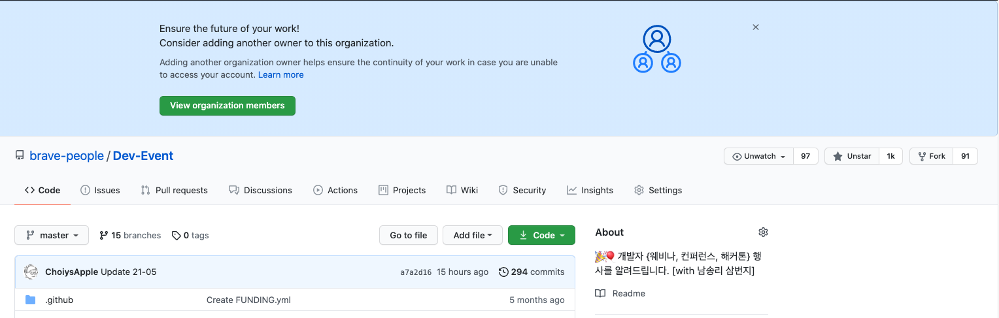

Slide 3
Notes:
첫 커밋
https://github.com/brave-people/Dev-Event/blob/f0dfbe58c6d6053b8b94269f21fdf5fc1d068920/README.md

Slide 4
Notes:
위클리
https://github.com/brave-people/Dev-Event-Weekly-News

Slide 5
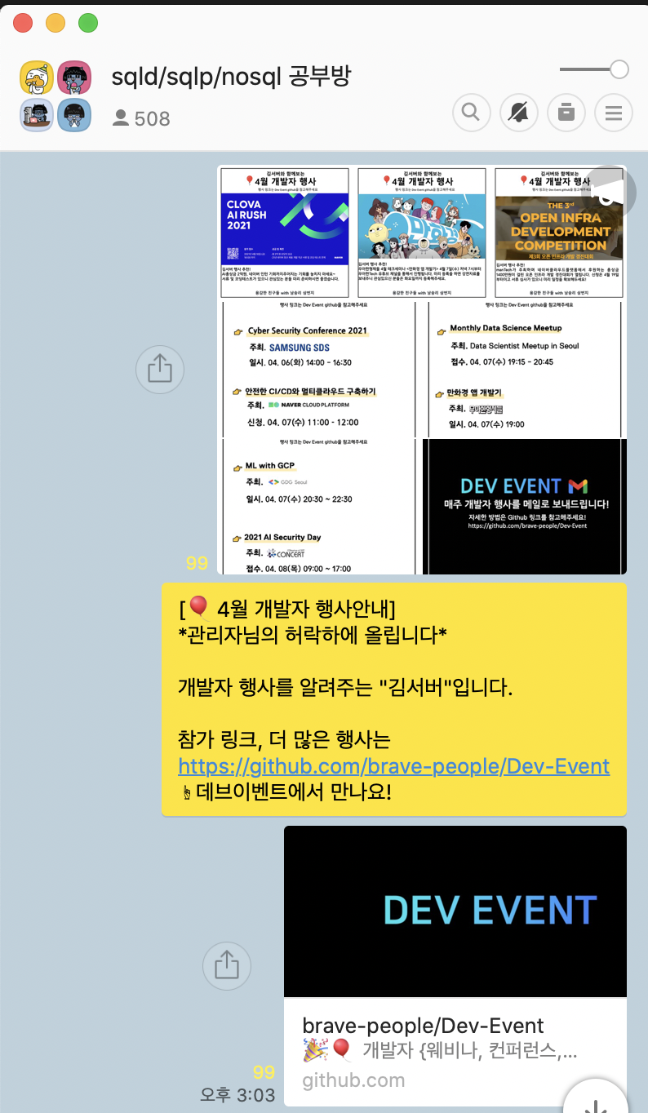

Slide 6
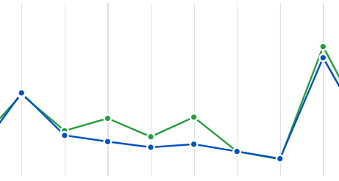
Notes:
View
https://github.com/brave-people/Dev-Event/graphs/traffic

Slide 7
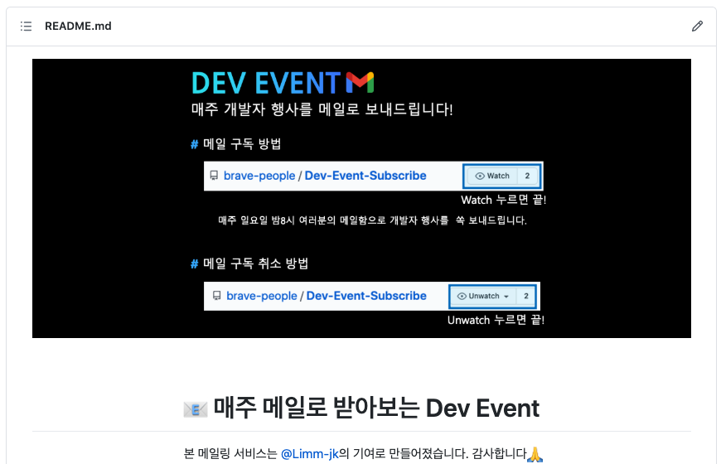
Notes:
Automailing
https://github.com/brave-people/Dev-Event/issues/16

